Slide 1
Data Modeling
High Level Overview

Slide 2
Objectives
What is Data Modeling?
Different types of Data Modeling?
OLTP vs OLAP
Normalization
Denormalization
Facts
Dimensions
The Star Schema
The Snowflake Schema
The Project

Slide 3

What is Data Modeling?
In a library, we need to classify all books and arrange them on shelves to make sure we can easily access every book.

Slide 4
What is Data Modeling?
Similarly, if we have massive amounts of data, we need a system or a method to keep everything in order.
The process of sorting and storing data is called “data modeling”.

Slide 5
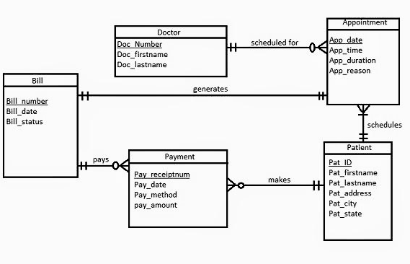
Data Modeling
Data modeling is a process that involves identifying the entities (items to be stored) and the relationships between entities.

Slide 6
Different Worlds of Data Capture and
Data Analysis
One of the most important assets of any organization is its information.
This asset is almost always used for two purposes: operational record keeping (operational systems) and analytical decision making (DW/BI system).
Users of an operational system turn the wheels of the organization.
Users of a DW/BI system, on the other hand, watch the wheels of the organization turn to evaluate performance.

Slide 7
Transactional database design (OLTP)
OLTP performance is about inserting and updating quickly.
Locking must be minimized.
Very small sets of data is retrieved in a query.
Data consistency is critical.
Laws of normalization.
The primary objective is data processing and not data analysis.
Focus is on the customer(s) entering data
Notes:
How does a database lock work?
When data is locked, then that means that another database session can NOT update that data until the lock is released (which unlocks the data and allows other database users to update that data. Locks are usually released by either a ROLLBACK or COMMIT SQL statement.

Slide 8
Reporting database design (OLAP)
A copy of OLTP data.
Performance is about retrieving the data quickly.
Locking is not an issue.
Large sets of data is retrieved in a query
Insert and update speed is not important.
The primary objective is data analysis and not data processing.
Focus is on the End User Running Queries
Notes:
How does a database lock work?
When data is locked, then that means that another database session can NOT update that data until the lock is released (which unlocks the data and allows other database users to update that data. Locks are usually released by either a ROLLBACK or COMMIT SQL statement.

Slide 9
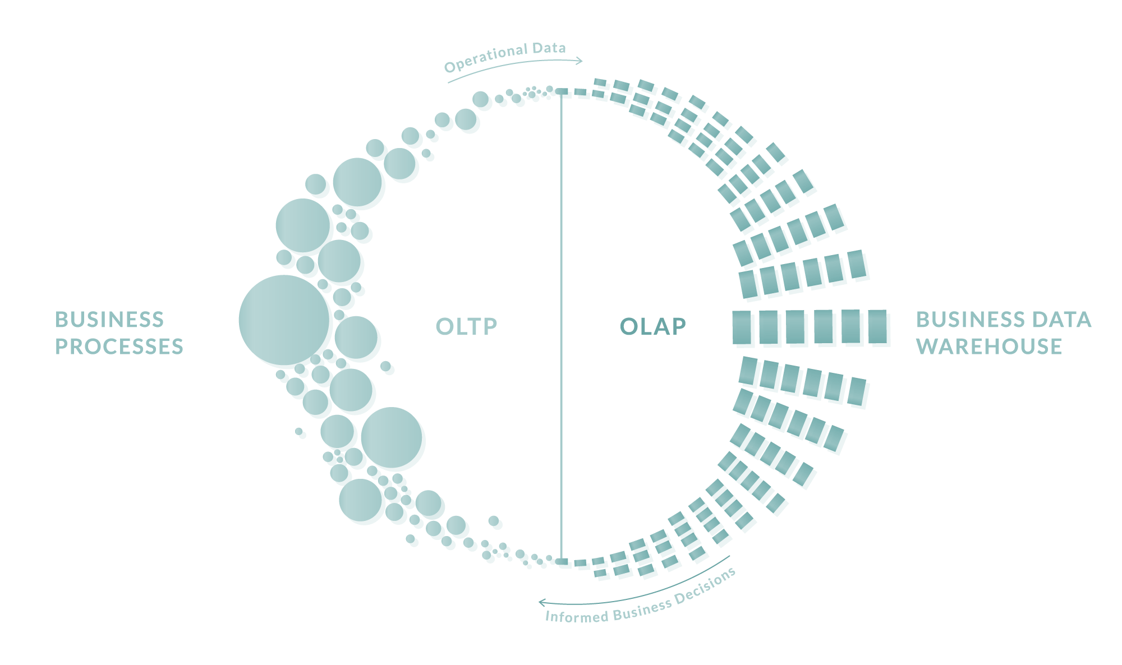

Slide 10
Normalization
Normalization is a process of systematically breaking a complex table into simpler ones.
It is built around the concept of normal forms.
Why?
Eliminate certain types of data (redundancy|replication) to improve consistency.
Produce a clearer and readable data model.
Provide maximum flexibility to meet future information needs by keeping tables corresponding to object types in their simplified forms.

Slide 11
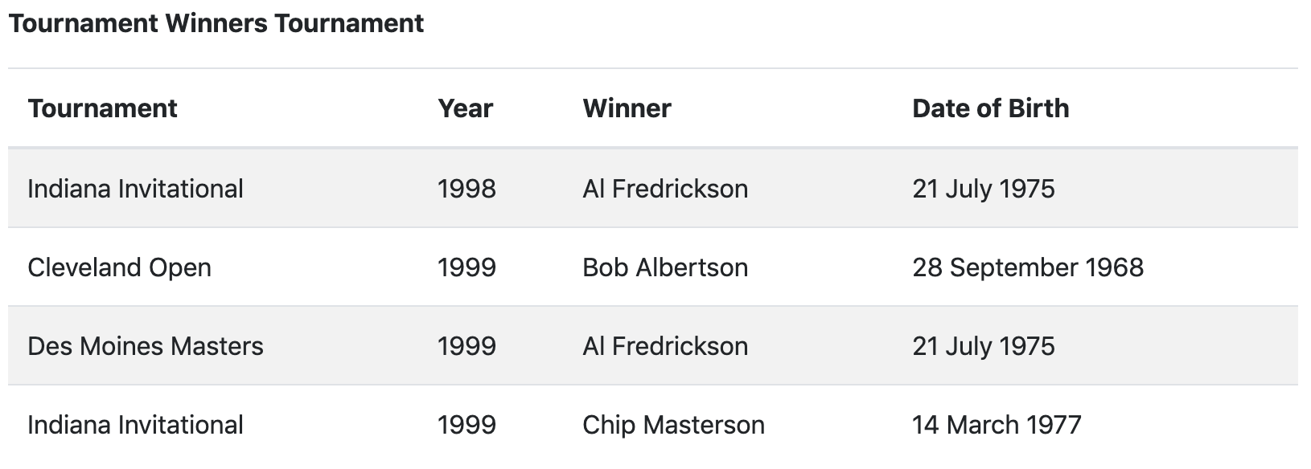
Normalization Example
An example of a 2NF table that fails to meet the requirements of 3NF:

Slide 12
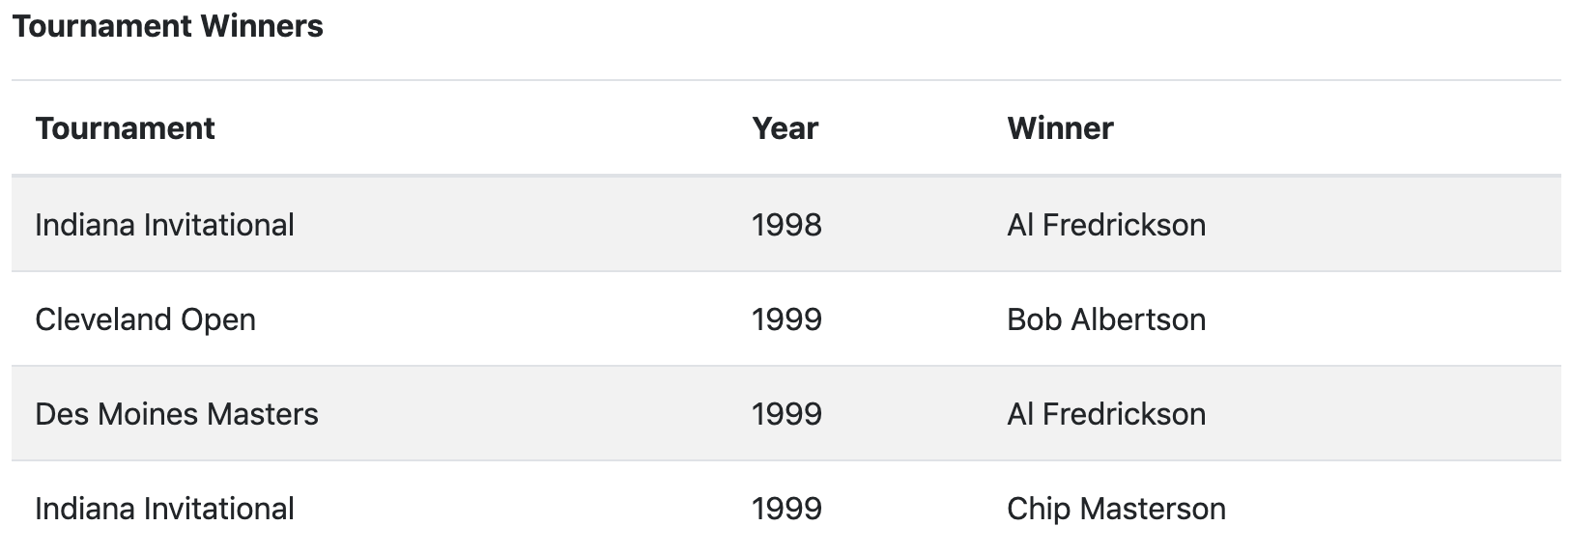
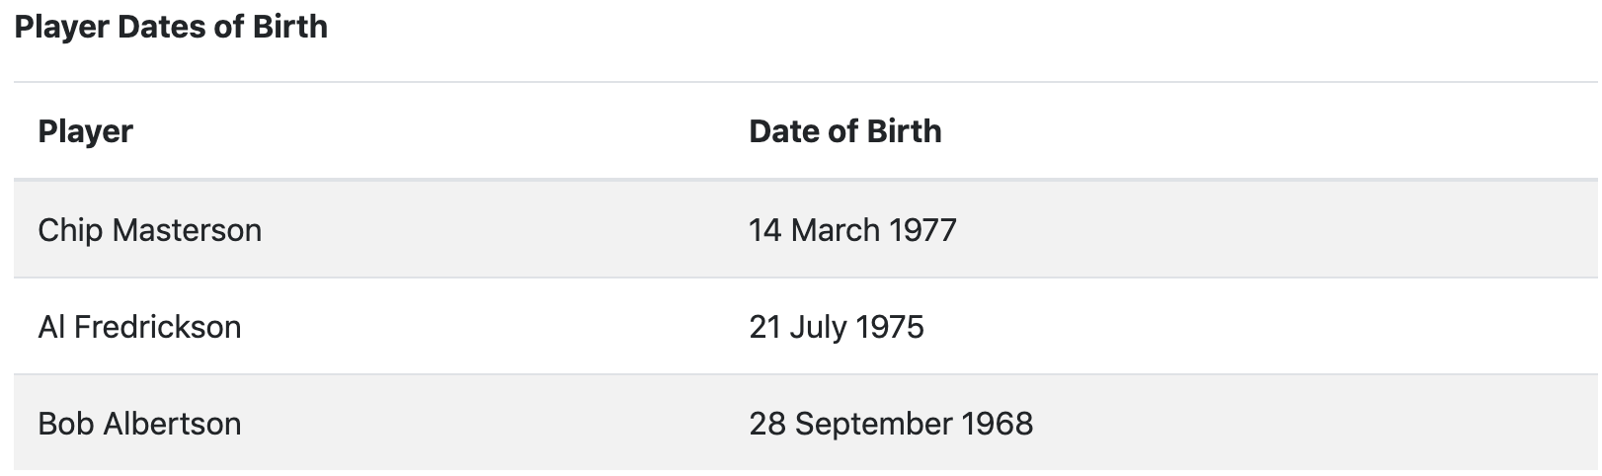
3NF/2NF Normalization Example

Slide 13
Normalization: Pros and Cons
Pros
Cons
Reduce data redundancy & space required
Enforce data integrity
Reduce update cost
Provide maximum flexibility in responding ad hoc queries
Can reduce the total number of rows per block.
It can lead to complex queries.
Programmers/users have to understand the underlying data model.

Slide 14
Denormalization
Denormalization is a database optimization technique in which we add redundant data to one or more tables.
Applied after doing normalization.
Why?
Can help us avoid costly joins.
Reduce the complexities when retrieving data for the end user.

Slide 15
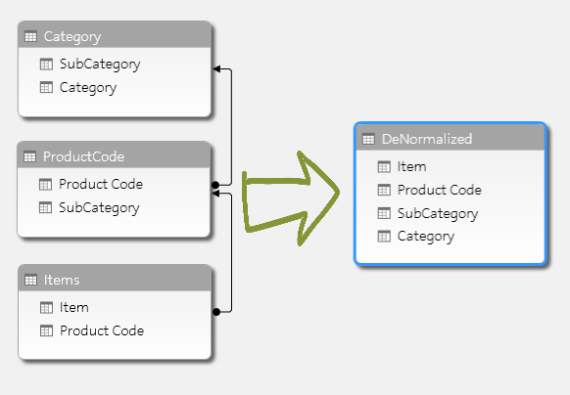
Denormalization

Slide 16
Denormalization: Pros and Cons
Pros
Cons
Retrieving data is faster since we do fewer joins
Queries to retrieve can be simpler(and therefore less likely to have bugs), since we need to look at fewer tables.
Updates and inserts are more expensive.
Denormalization can make update and insert code harder to write.
Data redundancy necessities more storage.

Slide 17
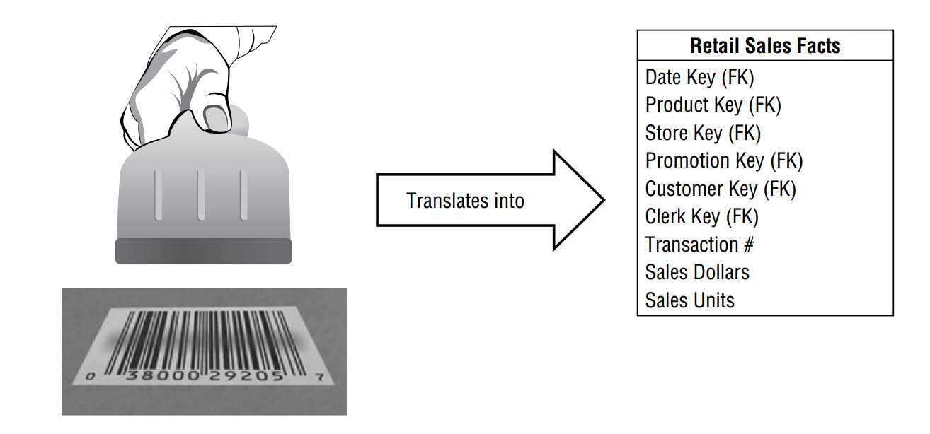
Fact Tables
The fact table in a dimensional model stores the performance measurements resulting from an organization’s business process events.
Also called a measure.
Business processes are the operational activities performed by your organization, such as taking an order, processing an insurance claim, registering students for a class.

Slide 18
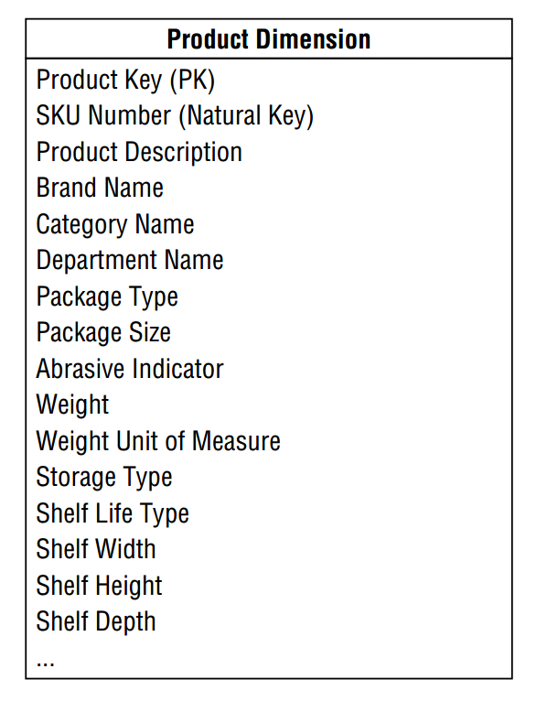
Dimension Tables for Descriptive Context
Dimension tables are integral companions to a fact table.
The dimension tables contain the textual context associated with a business process measurement event.
They describe the “who, what, where, when, how, and why” associated with the event.

Slide 19
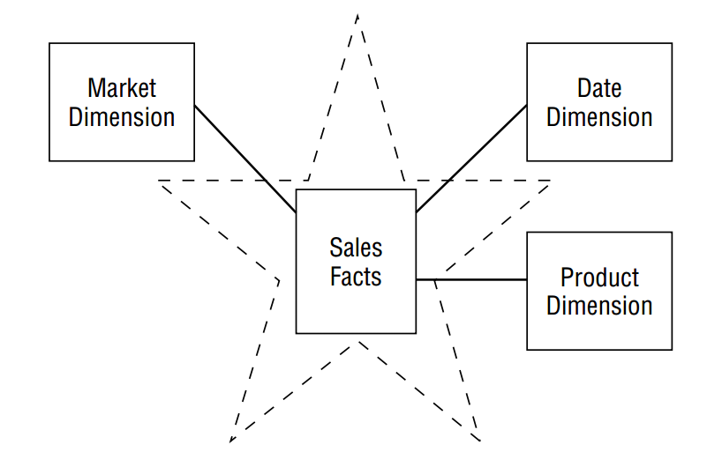
Star Schema

Slide 20
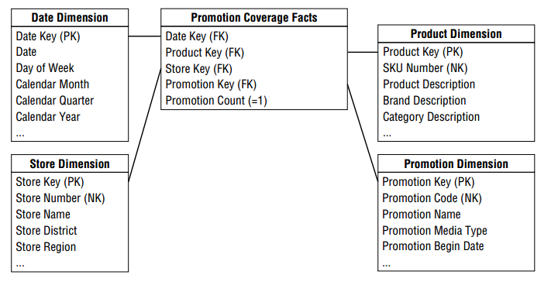
Star Schema

Slide 21
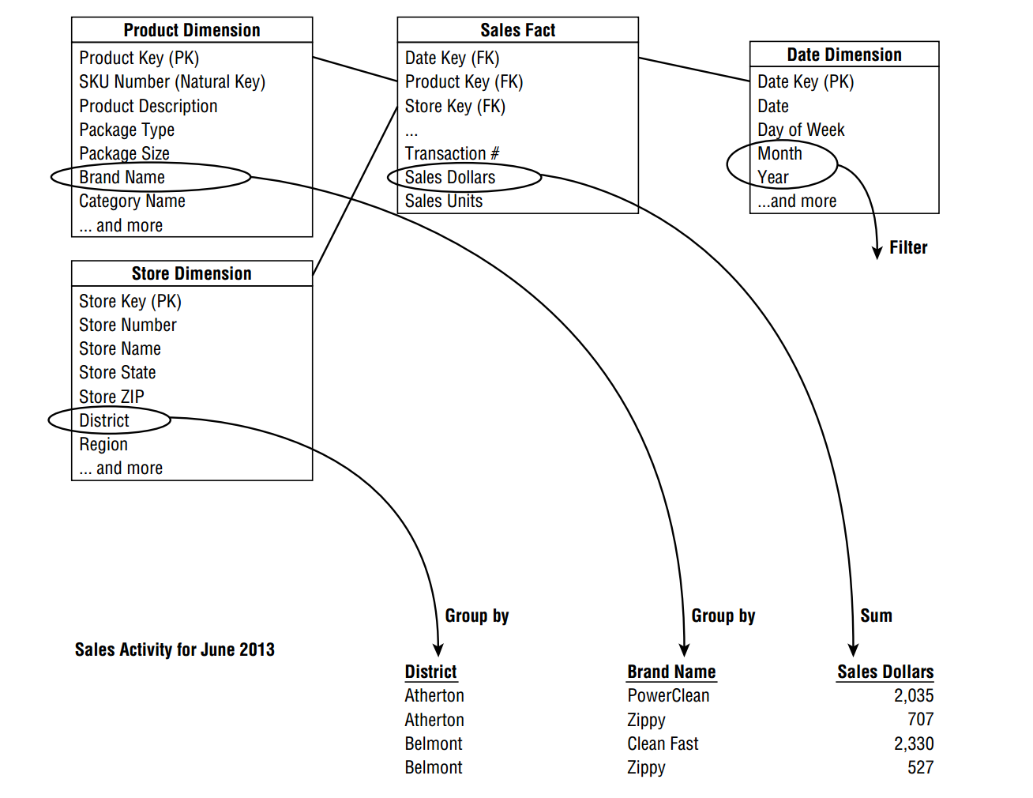
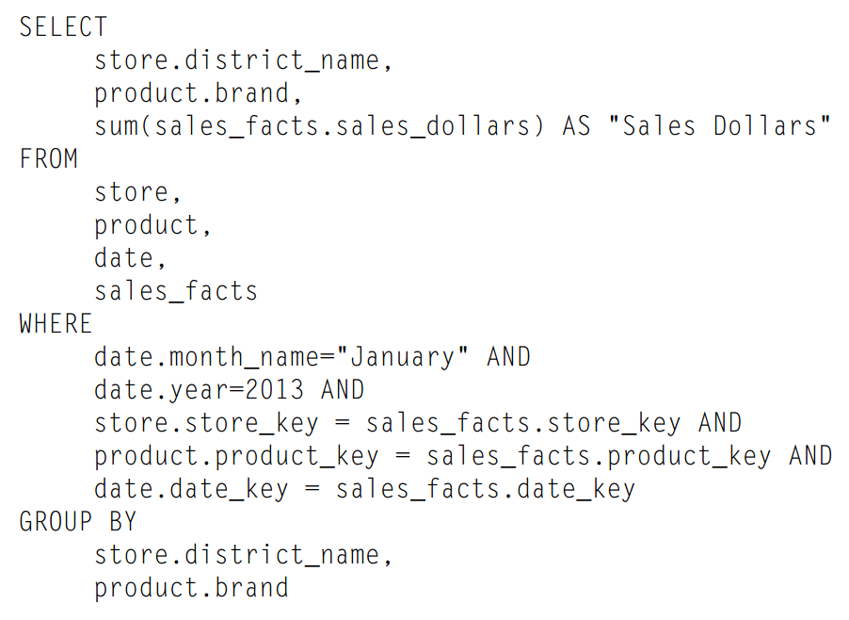

Slide 22
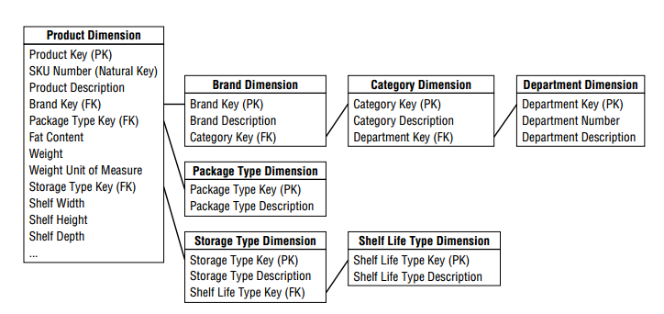
Snowflake Schema

